Slide 1
Propagation Models
Radio transmission takes place over a variety of irregular terrain.
The terrain profile need to be taken into account for estimating the path loss.
Different Models have been developed to meet the needs of realizing the propagation behavior in different conditions.
Types of models for radio propagation include
Outdoor Propagation Model
Indoor Propagation Model.

Slide 2
Outdoor Propagation Models
Types of outdoor Propagation model
Terrain Models
- Longley Rice Model
Parametric Models
- Okumura Model
- Hata Model

Slide 3
Outdoor Propagation Models
Terrain Models
Longley-Rice Model
- Also called as Irregular Terrain model.
-Applicable to point to point communication.
- Frequency range from 40MHz to 100GHz over
various different kinds of terrain
- Applicable only for Irregular Terrain.
- It doesn’t take into account buildings or trees.
Two Modes of operation:
Point to point mode Prediction - Terrain path profile available, easy to determine path specific parameters.
Area Mode prediction: Terrain path profile not available

Slide 4
Okumura Model
Widely used for signal prediction in urban areas.
The Okumura model for urban areas is a Radio propagation model that was built using the data collected in the city of Tokyo, Japan.
Developed during the mid 1960's
Applicable for:
frequency f: 150 MHz - 1920 MHz
distance d: 1 km - 100 km
Free Space path loss is given by
[L] = L_{f} + A_{mu}(f,d) – G(h_{te}) – G(h_{re}) -G_{area}
L_{f} is the free space propagation loss
A_{mu} is the median attenuation relative to free space
G(h_{te})- Base station antenna height gain factor
G(h_{re})- Mobile antenna height gain factor.
G_{area} - Gain due to type of environment
This model is based only on the measured data.

Slide 5
Okumura Model
G(h_{te}) –varies at rate 20dB/decade
G(h_{re})- varies at the rate 10dB/decade Heights < 3m
G(h_{te})= 20 log(h_{te}/200) 1000m>h_{t}>30m
G(h_{re} )=10 log (h_{re}/3) h_{re}≤ 3m
G(h_{re}) = 20log(h_{re})/3) 10m>h_{te}>3m

Slide 6
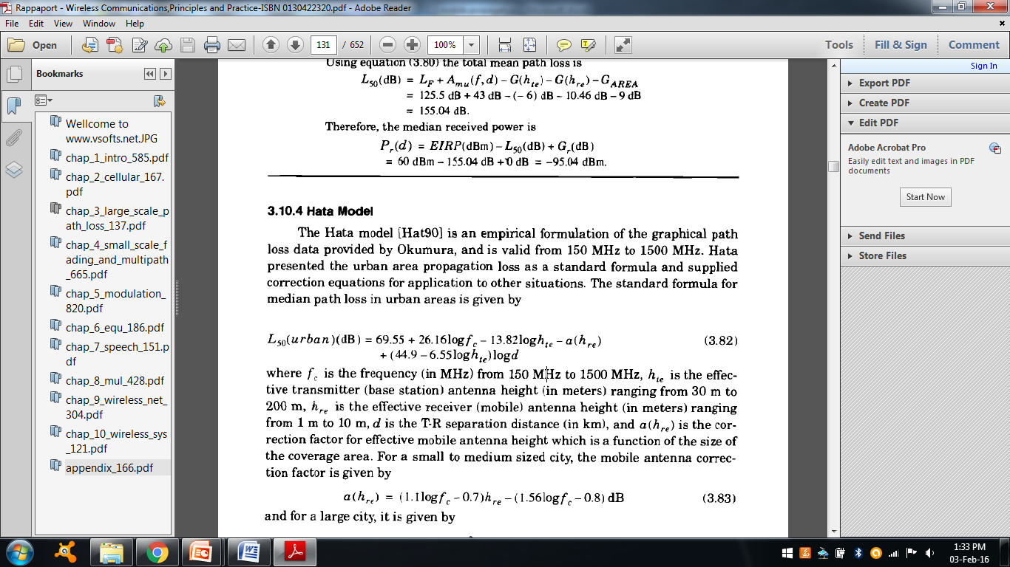
Hata Model
The Hata model is an empirical formulation of the graphical path loss data provided by Okumura.
It is valid from 150 MHz to 1500 MHz.
fc - frequency (in MHz) from 150 MHz to 1500 MHz.
h_{te} –effective transmitter (base station) antenna height
h_{re} - effective receiver (mobile) antenna height
d - T-R separation distance.
α_{hre}- correction factor for effective mobile antenna height (Function of the size of the coverage area)

Slide 7
Hata Model
Small to medium size city,
α_{hre} = (1.1logf_{c}-0.7)h_{re} – (1.56logf_{c}-0.8) dB
For Large Cities,
α_{hre} = 8.29(log 1.54h_{re})2 – 1.1 dB f_{c} ≤ 300Mz
α_{hre} = 3.2(log11.75h_{re})2- 4.97dB f_{c}>300Mhz
The predictions of HATA model compare closely with okumura model as long as d exceeds 1KM
Model is suited for large cell mobile systems but not personal communication systems which have cells of radius 1Km.

Slide 8
Indoor Propagation Losses
Partition Losses
Partitions that are formed as a part of the building structure are called hard partitions.
Partitions that may be moved are called soft partitions.
Partitions vary in their physical and electrical characteristics and hence variations in loss depending on the material .
Example:
Alluminum sliding 20.4dB at 815 MHz
Concrete wall – 13dB at 1300Mhz
Heavy textile inventory- 8-11dB at 1300Mz

Slide 9
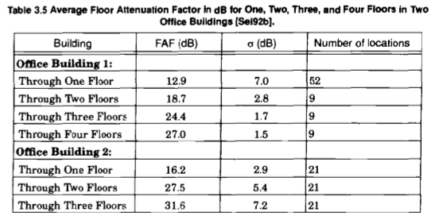
Indoor Propagation Losses
Losses between the floors:
The losses between the floors of a building are determined
- Materials of the building
Courtesy to Theodore S. Rappaport
©2002, 1996 Prentice Hall PTR

Slide 10
Log Distance Path Loss Model
Indoor propagation loss obey the distance power law equation
PL(dB)= PL(d₀) +10nlog(d/d₀) +x_{σ}
n – depends on surrounding and building type.
x_{σ :} Normal random variable in dB having standard deviation of σ.

Slide 11
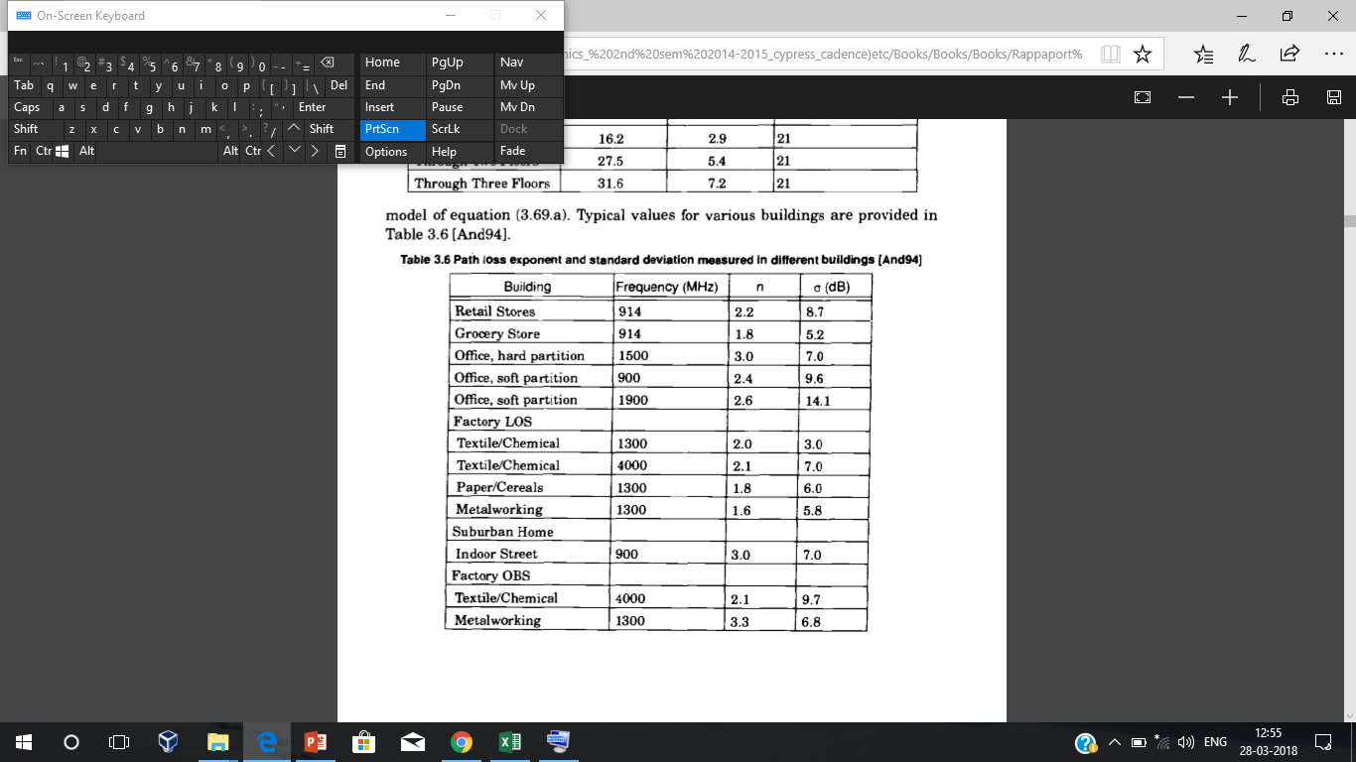
Log Distance Path Loss Model
Courtesy to Theodore S. Rappaport
©2002, 1996 Prentice Hall PTR

Slide 12
Summary
Longley rice model is the terrain model suitable in the range of frequency 400MHz to 100GHz
Various Parametric models like Okumura model and Hata model for urban areas.
Indoor propagation losses like partition loss, floor loss depends on the material used, their physical and electrical characteristics.

